Slide 1
Language: Its properties
Lecture 2
August 17, 2018
Dipti Misra Sharma

Slide 2
What is language?
What is the function of language in our lives?
Do the other living beings also have 'language'?
How is our (human) language different from animal communication?
What does it have in common with animal communication?
But before we delve into these questions, let us look at what is meant by 'communication'?

Slide 3
What is 'language'?
lan·guage
/ˈlaNGgwij/
Noun
1. The method of human communication, either spoken or written, consisting of the use of words in a structured and conventional way.
2. Any nonverbal method of expression or communication: "a language of gesture and facial expression".

Slide 4
Language as defined by linguists (taken from https://www.thoughtco.com/what-is-a-language-1691218)
“Language is a purely human and non-instinctive method of communicating ideas, emotions and desires by means of voluntarily produced symbols."
(Edward Sapir, Language: An Introduction to the Study of Speech. Harcourt, Brace and Company, 1921)
"A language is a system of arbitrary vocal symbols by means of which a social group cooperates."
(B. Bloch and G. Trager, Outline of Linguistic Analysis. Waverly Press, 1942)
From now on I will consider a language to be a set (finite or infinite) of sentences, each finite in length and constructed out of a finite set of elements."
(Noam Chomsky, Syntactic Structures, 1957)

Slide 5
"[L]anguage is behaviour which utilizes body parts: the vocal apparatus and the auditory system for oral language; the brachial apparatus and the visual system for sign language. . . . Such body parts are controlled by none other than the brain for their functions."
(Fred C.C. Peng, Language in the Brain: Critical Assessments. Continuum, 2005)
"A language consists of symbols that convey meaning, plus rules for combining those symbols, that can be used to generate an infinite variety of messages."
(Wayne Weiten, Psychology: Themes And Variations, 7th ed. Thomson Wadsworth, 2007)
"We can define language as a system of communication using sounds or symbols that enables us to express our feelings, thoughts, ideas, and experiences."
(E. Bruce Goldstein, Cognitive Psychology: Connecting Mind, Research, and Everyday Experience, 2nd ed. Thomson, 2008)

Slide 6
Communication
We use signals in communication
Signals carry information
Are all information signals communicative?

Slide 7
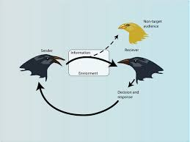
Communication Systems
Sender
Receiver
message
message
encode
decode
signal
signal
Channel
(Vocal-auditory/written)‏
Medium : Sounds/orthographic symbols
(human language)‏

Slide 8
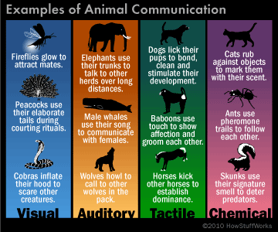

Human Language and Animal/Bird/Insect language
Substantial research on these
Animal communication is "the transmission of a signal from one animal to another such that the sender benefits, on average, from the response of the recipient". (definition by Slater (1983))

Slide 9
Animal Communucation
Animal communication includes:
  Chemical signals (used by some very simple creatures, including protozoa (protozoa were defined as single-celled animals or organisms with animal-like behaviors))
  Smell (related to chemical signals, eg. pheromones attract, skunk secretions repel)
  Touch
  Movement
  Posture (eg. dogs, geese)
  Facial gestures (eg. dogs snarling)
  Visual signals (eg. feathers)
  Sound (eg. very many vertebrate and invertebrate calls)

Slide 10

Functions
Natural animal communication can include:-
Communication during contests
Attract (especially mates)
Repel (especially competitors or enemies)
Ownership/territorial
Signal aggression or submission
Alarm calls
Communicate about the environment or the availability of food
These signals may be
  Instinctive, that is genetically programmed
  Learnt from other
(Source http://clas.mq.edu.au/speech/animal_communication/)

Slide 11
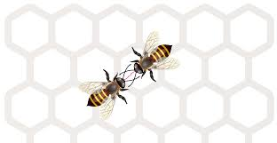
Honey bee 'language'
The worker honey bee communicates the location of the source of nectar by its dance movements and tail wagging
Worker bee finds the source of honey
Returns to the hive and spells out to the recuiter bees the
  Distance and
  Direction of the source of nectar.
The dance is to recruite more bees to forage the honey

Slide 12
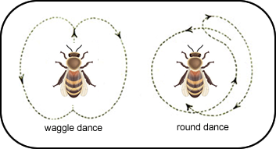
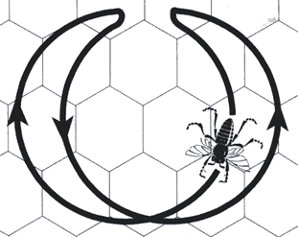

Distance
If the source is close to the hive (less than 50 meters), the bee performs the round dance
If the distance is between 50 – 150 meters, sickle dance
If the distance more than 150, then waggle dance
Sickle dance

Slide 13
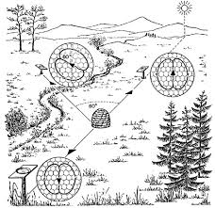
Direction
The orientation of the dancing bee during the straight portion of her waggle dance indicates the location of the food source relative to the sun

Slide 14
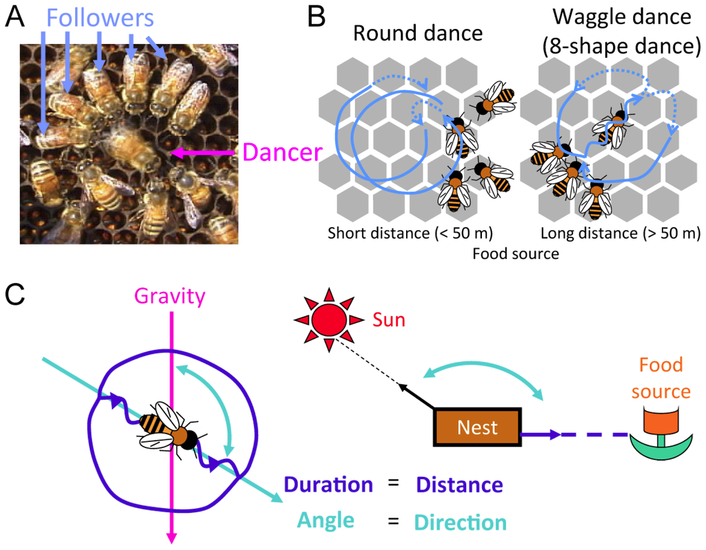
Bee Communication

Slide 15
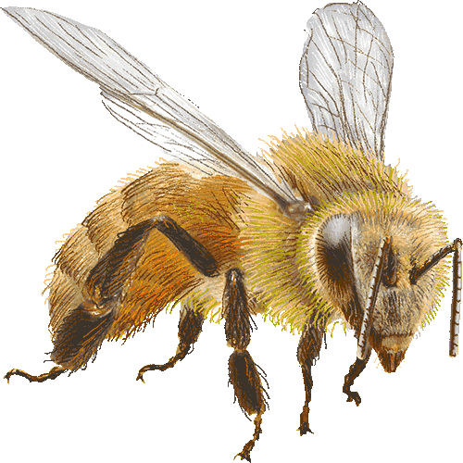
Dialect Differences
Carniolan bees do not do a Sickle Dance but change to the Wagtail Dance at about 90 meters.
Italian and Caucasian bees change to the Wagtail Dance at about 40 meters
The races use the same direction language but distance is wrongly interpreted.

Slide 16
What is common in human and animal language?
Vocal systems
Grammar (??)
One question to be raised :
Is language innate or do we acquire it?
  Chomsky (1957) claims that
    human have a faculty for language
      have an innate universal grammar.
      No other species has it.
  Alternate theory, human beings acquire language
  Do animals also acquire language?

Slide 17


Human Language
Human language differs from animal/insect communication systems in several ways
Basic Properties (not a fixed set)
  Arbitrariness
  Displacement
  Productivity/Creativity
  Cultural transmission
  Duality

Slide 18
Arbitrariness
No obvious connection between the form and the meaning
Example : chair
Composed of a series of sounds. Neither the entire word nor do the sounds it is composed of by themselves indicate anything that is even remotely connected with the object they refer to. The concept behind 'chair' is acquired through association not because it has something inherently in it.
Exercise : Utter words for certain objects in your language.
Others try and guess what it means from how it sounds)

Slide 19
Arbitrariness
Onomatopoeia : Given the form meaning can be predicted
jham jham, bhau bhau, cham cham etc

Slide 20

Displacement
We can talk about things which happened in the past or might happen in future
An animal cannot tell that she will eat after a week or she had too much for lunch, hence would skip the dinner.
We can also talk about things which are happening at a distance
We can discuss about the world in 2112.

Slide 21
Productivity/Creativity
We can add new words
  google, googlable
We construct new sentences all the time
A child forms utterances that she has never heard before
This brings in the infiniteness to the creation of new words/sentences using the finite set of rules/parts
Etc

Slide 22

Cultural Transmission
We acquire language from our environment in a culture
Children acquire language from their parents and family
Unlike the color of their eyes (or other physical features), the language is not inherited from the parents
Animals use language instinctively
A human baby kept in isolation cannot acquire a language

Slide 23

Duality
Human language is organized at two levels
Sounds which by themselves do not carry any meaning(Phonetics)
But organize them in a pattern and they become meaningful (Phonology, morphology)
Similarly, words compose a larger unit sentence etc.
This gives the human language a property of being economical.
With a limited number of speech sounds we can produce an infinite number of meaningful structures

Slide 24
Study of Language (Linguistics)
Saussure (1916)
  Language is a system of signs
  Which has signifier and signified
Synchronic and diachronic
  Study of the history of language
  Study of a state of language at any given time
2. Structure
a) Syntagmatic relations and
Every item of language hasa syntagmatic relationship with items which occur within the same construction
b) Paradigmatic relations
Every item of language has a paradigmatic relationship with every other item which can be substituted for it

Slide 25


Paradigmatic vs Syntagmatic
Paradigmatic
  Vertical, non-linear and associative
Associative : represents the relationship between individual elements in specific environments with such elements in the memory which can potentially replace them.
  Substitution test
  Example : beer, deer, peer
  Selection and distribution of linguistic elements
  Selection amongst possible alternatives
Syntagmatic
  Horizontal, linear and sequential
  Ability of elements to be combined horizontally
  Syntactic and semantic conditions the words in a syntagmatic relation must meet
  Process of combination

Slide 26


Structure
Assumes parts
  Sounds : Two aspects
    Phonetics : physical properties of sounds (p,t,k)
    Phonology : how sounds function (are organized) in a language (pick, tick, kick, *pnick)
  Words
    Morphology : parts of words and how they combine to give us words (boy, boys)
  Phrases
    Syntax : group of words which together give a meaning (the recent book, the nearby market, have been thinking)
  Sentences
    Syntax : how words are combined to give larger meaningful unit

Slide 27
Units
Sounds: B a r b a r a, d u r i ng h e r n u r s e 's t r ai n i ng a t a h o s p i t a l j u s t o u t s i de W a sh i ng t o n, D C, h a d l i tt le m o n ey f o r m ea l s, s o sh e o ft e n r e s o r t e d t o th e f oo d p r o v i d e d a t th e h o s p i t a l r e f e c t o r y, e v e n th ou gh sh e h a d a g r ea t d i s l i ke f o r i t s r a th e r b l a n d t a s te.
Sound units(syllables): Bar ba ra , du ring her nur se's train ing at a hos pi tal just out side Wa shing ton , D C , had li ttle mo ney for meals , so she oft en re sor ted to the food pro vi ded at the hos pi tal re fec tory , e ven though she had a great dis like for its ra ther bland ta ste.
Words: Barbara, during her nurse's training at a hospital just outside Washington, DC, had little money for meals, so she often resorted to the food provided at the hospital refectory, even though she had a great dislike for its rather bland taste.

Slide 28
PARTS OF SPEECH: Barbara, during her nurse's training at a hospital just outside Washington, DC, had little money for meals, so she often resorted to the food provided at the hospital refectory, even though she had a great dislike for its rather bland taste.
PHRASES: Barbara, during her nurse's training at a hospital just outside Washington, DC, had little money for meals, so she often resorted to the food provided at the hospital refectory, even though she had a great dislike for its rather bland taste.
CLAUSES: ((Barbara, during her nurse's training at a hospital just outside Washington, DC, had little money for meals)),
so
((she often resorted to the food provided at the hospital refectory)),
even though
((she had a great dislike for its rather bland taste)).
SENTENCE: Barbara, during her nurse's training at a hospital just outside Washington, DC, had little money for meals, so she often resorted to the food provided at the hospital refectory, even though she had a great dislike for its rather bland taste.

